Slide 1

A case study from US-based housing company named “Surprise Housing”. The company is looking at prospective properties to buy houses at a price below their actual values and flip them at a higher price which will help the company to enter the real estate market.
Surprise Housing Price Prediction Project Presentation
Submitted By Sri Bharath Vasa Flip Robo Intern

Slide 2
Introduction
Surprise Housing is a US based Real estate and housing company who is trying to entry into Australian Real estate market. The company is looking at prospective properties to buy houses to enter the market. We are required to build a model using Machine Learning in order to predict the actual value of the prospective properties and decide whether to invest in them or not.
For this Surprise Housing wants to know:
Which variables are important to predict the sale price of house?
How do these feature variables describe the price of the house?

Slide 3
Contents of Presentation
Analytical Problem Framing
Exploratory Data Analysis (EDA)
Visualizations
Data Pre-Processing on train and test datasets
Model/s Development and Evaluation
Performing hyper parameter tuning, saving the best model and predicting the label
Conclusion and future work discussion

Slide 4
Hardware Used
Hardware Used:
RAM: 12 GB
CPU:11th Gen Intel(R) Core(TM) i5-1135G7 @ 2.40GHz
GPU: intel iRIS Xe Graphics card

Slide 5
Software Used
Software Used:
Programming language: Python
Distribution: Anaconda Navigator
Browser based language shell: Jupyter Notebook
Libraries/Packages Used:
Pandas, NumPy, matplotlib, seaborn, scikit-learn and
pandas_profiling

Slide 6
Problem Statement
Houses are one of the necessary need of each and every person around the globe and therefore housing and real estate market is one of the markets which is one of the major contributors in the world’s economy. It is a very large market and there are various companies working in the domain.
Data science comes as a very important tool to solve problems in the domain to help the companies increase their overall revenue, profits, improving their marketing strategies and focusing on changing trends in house sales and purchases.
Predictive modelling, Market mix modelling, recommendation systems are some of the machine learning techniques used for achieving the business goals for housing companies. Our problem is related to one such housing company.

Slide 7
Analytical Problem we Have
As we are provided with two sets of data, one is for training and other for testing. Here we need to build a machine learning model using train dataset and then by using that model we will make predictions for test dataset.
Both the datasets are in csv format, train dataset has 1168 rows and 81 columns whereas test dataset has 292 rows and 80 columns. Here in the test dataset we do not have the target label and need to predict the same.
And as we have to predict house sale prices in this problem which is a continuous data, I will be using different regression machine learning models.

Slide 8
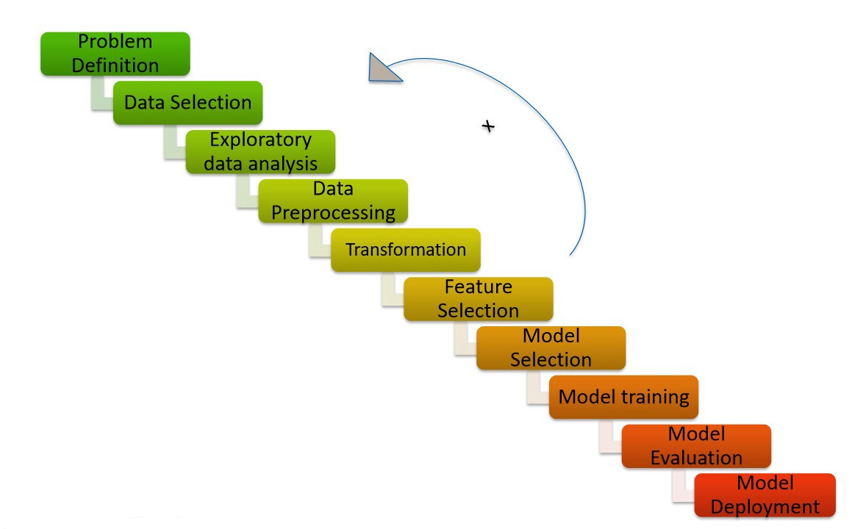
Data Analysis

Slide 9
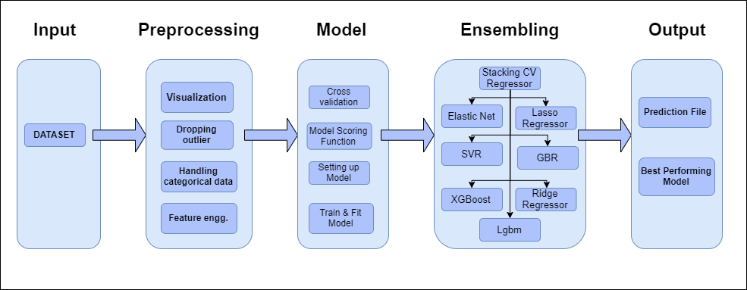

Slide 10
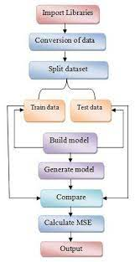
As seen in the above slides the libraries are imported first then test and train data are processed and model is built and MSE values are calculated and final prediction of output is obtained

Slide 11
EDA and Visualization
01. Univariate Analysis
04. Correlation with Target variable
Univariate analysis is the simplest form of analyzing data. “Uni” means “one”, so in other words your data has only one variable.
Correlation with the target variable to know how the data is related.
03. Correlation of Dataset
Correlation is used to test relationships between quantitative variables or categorical variables.
02. Multivariate Analysis
05. Conclusion
Multivariate analysis is a set of statistical techniques used for analysis of data that contain more than one variable.
Summary with the conclusion of all the analysis

Slide 12
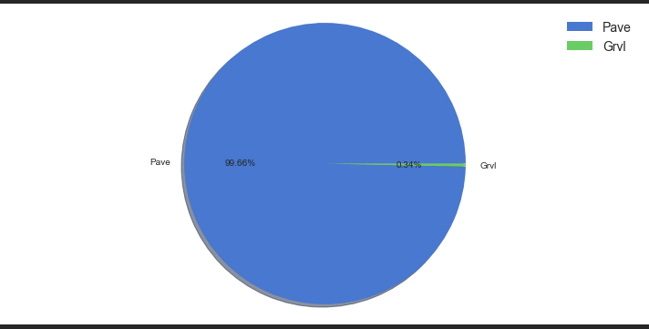
Pie Plot’s

Slide 13
A Pie Chart is a circular statistical plot that can display only one series of data.
The area of the chart is the total percentage of the given data.
The area of slices of the pie represents the percentage of the parts of the data.
The above slide pie chart compares different values and gives us complied information so as to know the rise and dip in the price of houses.

Slide 14
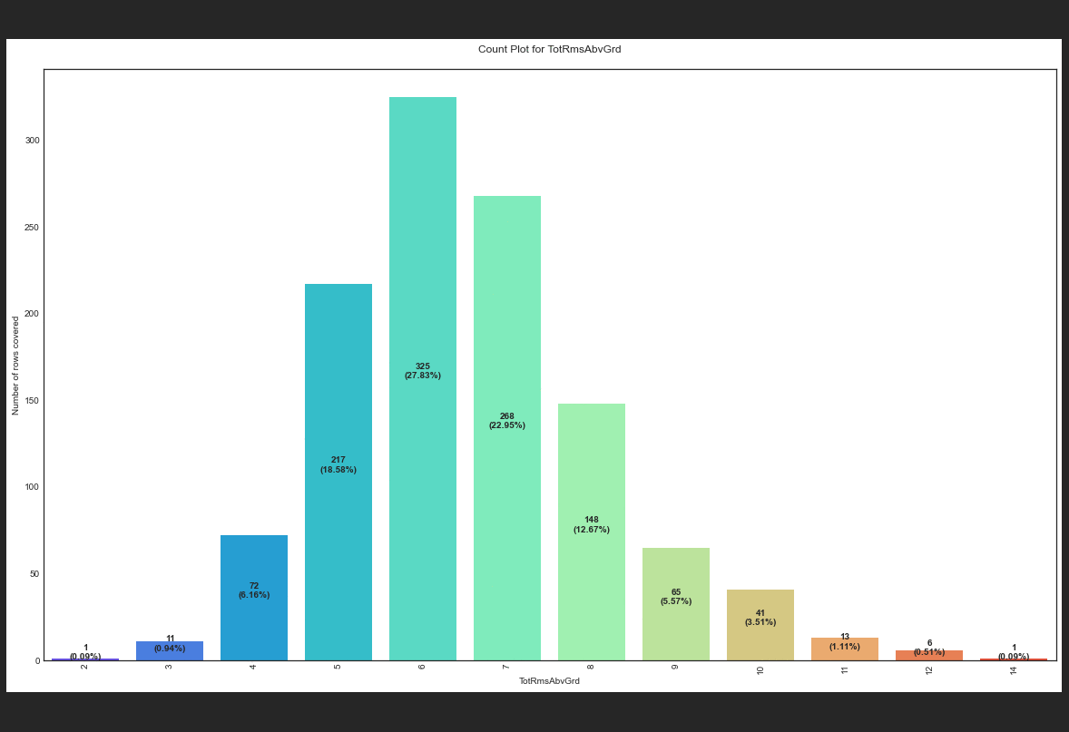
Count Plot’s

Slide 15
Count plot method is used to show the counts of observations in each categorical bin using bars.
Parameters : This method is accepting the following parameters that are described below: x, y.
This parameter take names of variables in data or vector data, optional inputs for plotting long-form data.
The Count plot gives us the comparison data across various factors like garage space, porch space, bath rooms, locality to number of rows. This charts gives us further insight on the change in house pricing.

Slide 16
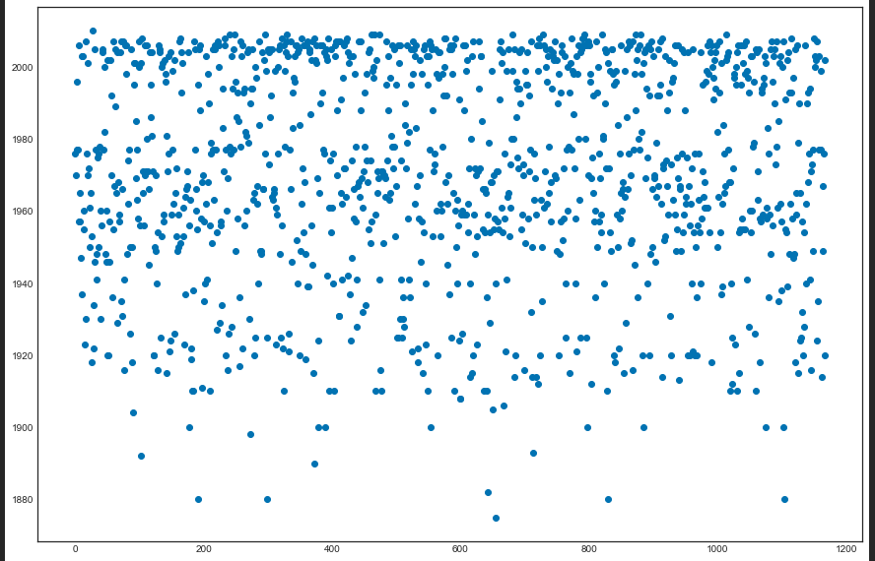
Scatter Plot’s

Slide 17
Scatter plots are used to observe relationship between variables and uses dots to represent the relationship between them.
The scatter method in the matplotlib library is used to draw a scatter plot.
Scatter plots are widely used to represent relation among variables and how change in one affects the other.
The density of dots in this chart gives us where the cluster of data are present and factors affecting.

Slide 18
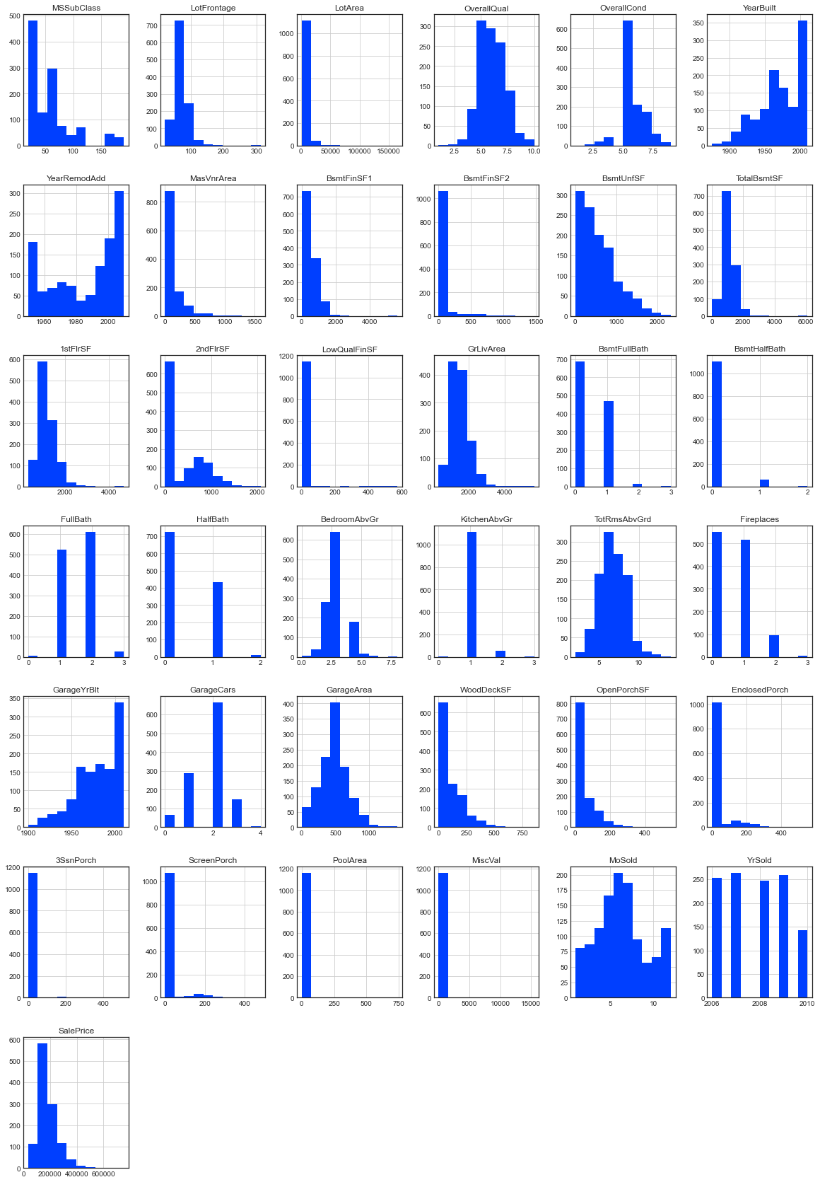
Histogram

Slide 19
A histogram is basically used to represent data provided in the form of some groups.
It is accurate method for the graphical representation of numerical data distribution.
It is a type of bar plot where X-axis represents the bin ranges while Y-axis gives information about frequency.
The histogram covers the comparison of various parameters and give us a numerical direction of the data processed.

Slide 20
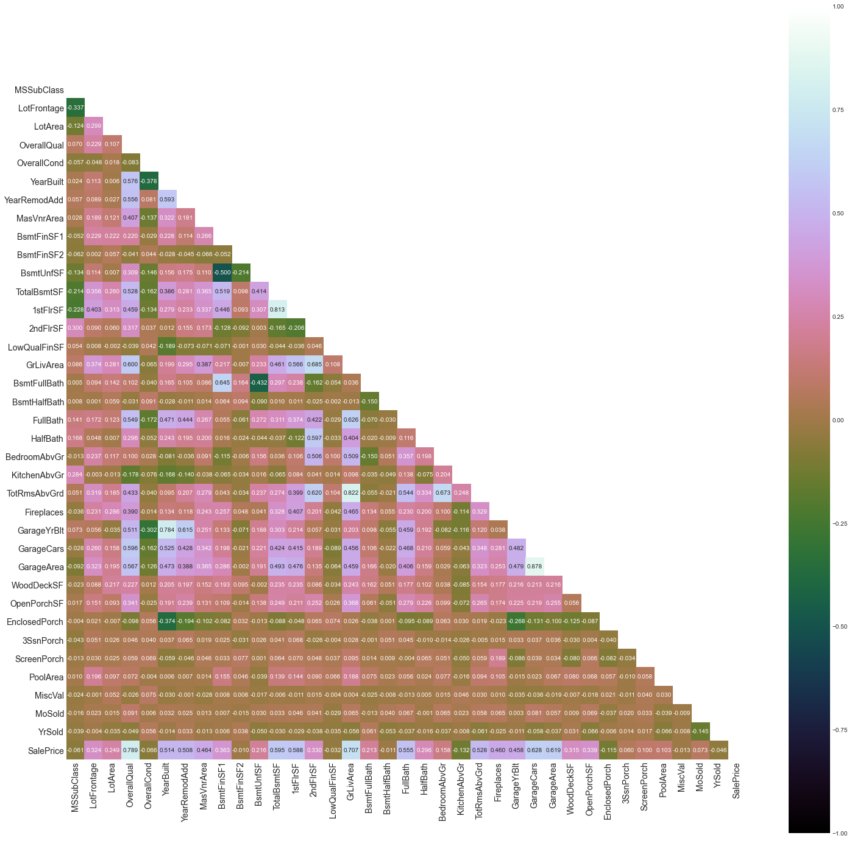
Heat Map

Slide 21
A heatmap contains values representing various shades of the same color for each value to be plotted.
Usually the darker shades of the chart represent higher values than the lighter shade.
For a very different value a completely different color can also be used.
The heat map gives us the positive and negative correlation values.

Slide 22
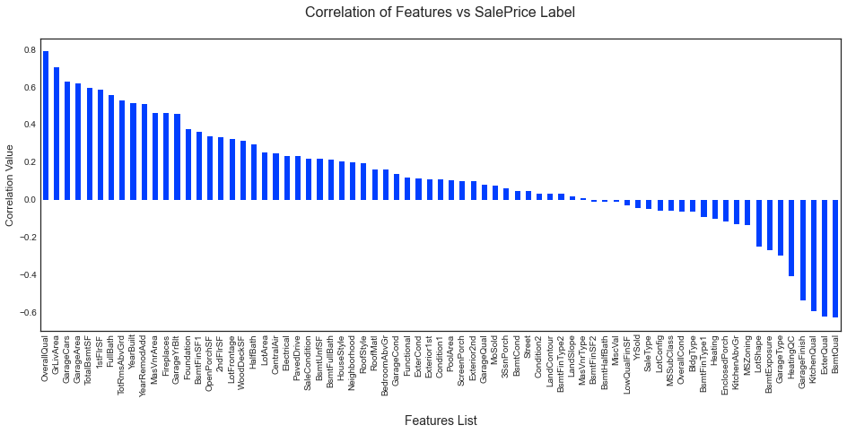
Bar Graph

Slide 23
Bar graphs are used to compare things between different groups or to track changes over time.
Here we are comparing the correlation values between the feature columns and the target label column which is Sale Price in our scenario.
It gives us an insight on positive and negative correlated column details and gives us further insight on the variables affecting the house price.

Slide 24
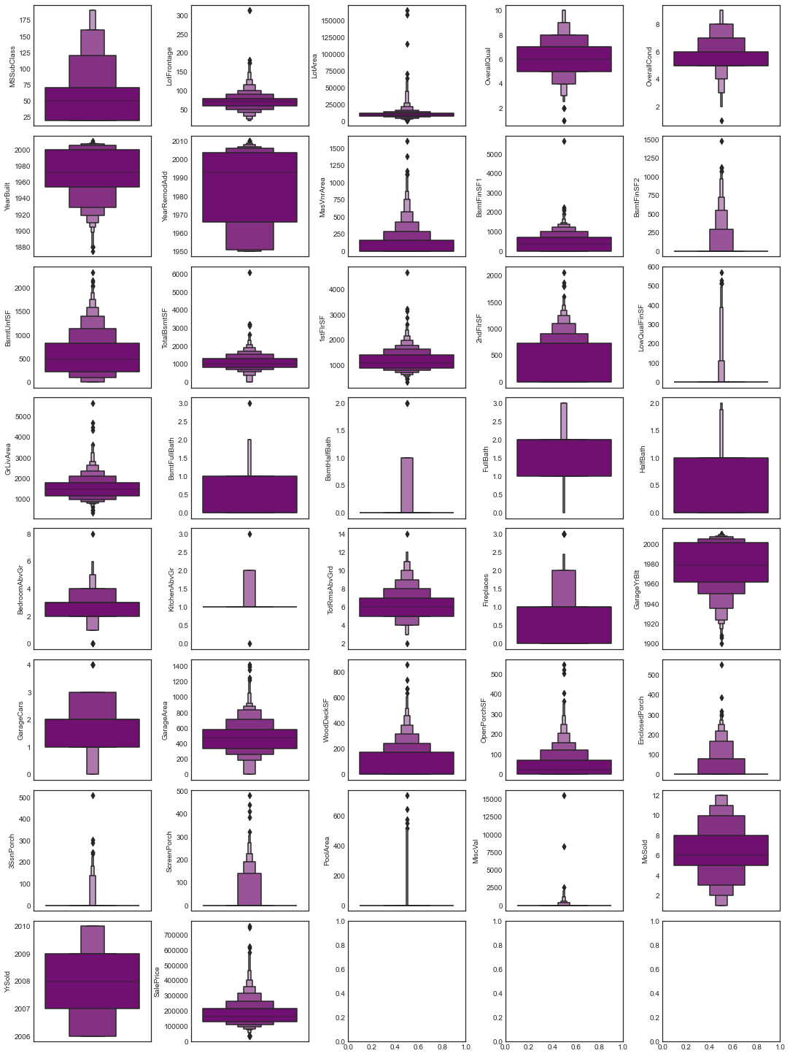
Boxen Plot

Slide 25
A Boxen Plot is also known as Whisker plot is created to display the summary of the set of data values having properties like minimum, first quartile, median, third quartile and maximum.
We have used it to identify the outlier details for all the numeric datatype column values.
Using the boxen plot we are able to see some outliers present however when tried to remove outliers we are losing around 58% of data and therefore decided on retaining the information.

Slide 26
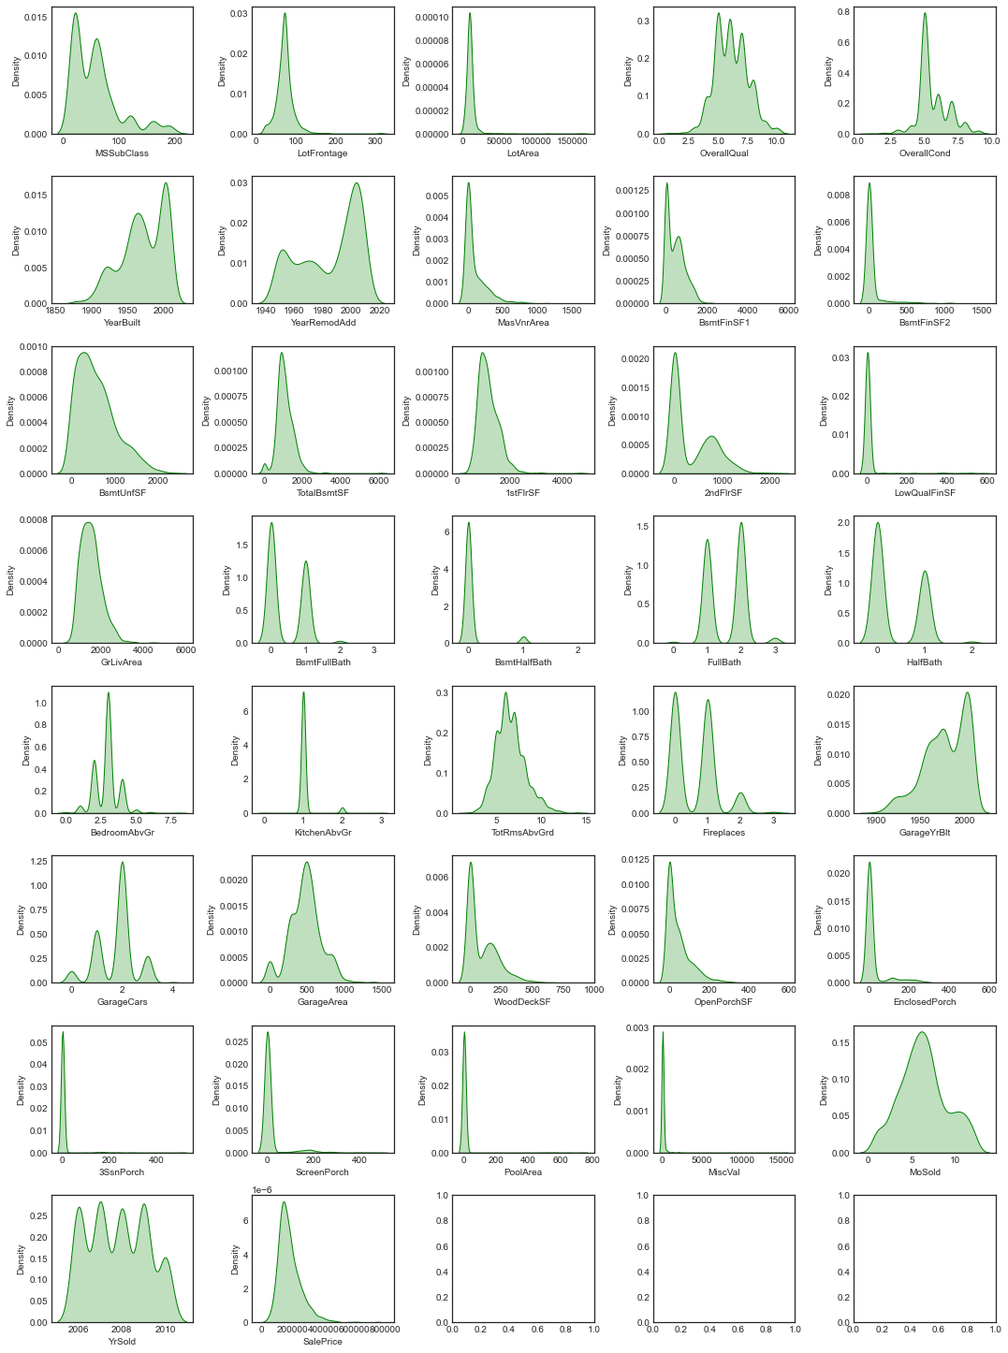
Distribution Plot

Slide 27
Distribution plots visually assess the distribution of sample data by comparing the empirical distribution of the data with the theoretical values expected from a specified distribution.
Here we have used it to analyze the skewness information for numeric datatype column values.
The acceptable form usually is a normal distribution resembling a bell shape curve.
Using the above distribution plot we are able to see some skewness present in few of the columns that will need to be handled.

Slide 28
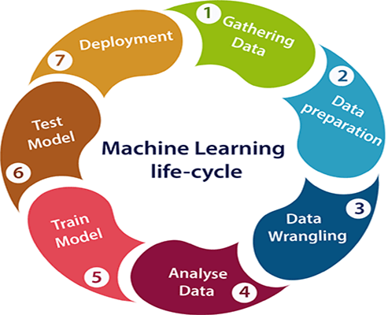
Model Training Phase

Slide 29
Model Development
The algorithms used on training and test data are as follows:
Linear Regression Model
Ridge Regularization Regression Model
Lasso Regularization Regression Model
Support Vector Regression Model
Decision Tree Regression Model
Random Forest Regression Model
K Nearest Neighbors Regression Model
Gradient Boosting Regression Model
Ada Boost Regression Model
Extra Trees Regression Model

Slide 30
Evaluation and Parameter Tuning
The key metrics used here were:
R2 score
Cross Validation Score
MAE
MSE
RMSE
We tried to find out the best parameters list to increase our accuracy scores by using Hyperparameter Tuning.
We achieved high score using Gridsearch CV method.

Slide 31
Conclusion
We have managed out how to prepare a model that gives users for a novel best approach with take a gander at future lodging value predictions. A few relapse strategies have been investigated Furthermore compared, when arriving during a prediction strategy.
The Grid search CV has given us the best score proving to be the best model.

Slide 32
Future Work
Future work on this study could be divided into seven main areas to improve the result even further. Which can be done by:
The used pre-processing methods do help in the prediction accuracy. However, experimenting with different combinations of pre-processing methods to achieve better prediction accuracy.
Make use of the available features and if they could be combined as binning features has shown that the data got improved.
Training the datasets with different regression methods such as Elastic net regression that combines both L1 and L2 norms. In order to expand the comparison and check the performance.
The correlation has shown the association in the local data. Thus, attempting to enhance the local data is required to make rich with features that vary and can provide a strong correlation relationship.

Slide 33
The factors that have been studied in this study has a weak correlation with the sale price. Hence, by adding more factors to the local dataset that affect the house price, such as GDP, average income, and the population. In order to increase the number of factors that have an impact on house prices.
The results of this study have shown that ANN is prone to overfitting. However, ANN still a strong algorithm that has a lot of options that could, with the right methods, provide a better prediction accuracy. ANN has a lot of possibilities that could lead to a different output. For instance, experimenting with the model when using combinations of layers and neurons over several iterations in order to find what fits the algorithm.
ANN model was designed using feed-forward architecture. The model could make use of applying the proper back-propagation method to reduce the weight between neurons and give a better training performance resulting in better prediction accuracy.

Slide 34


